Slide 1
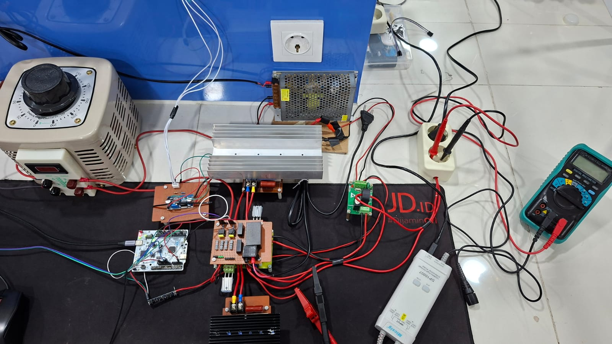

Slide 3
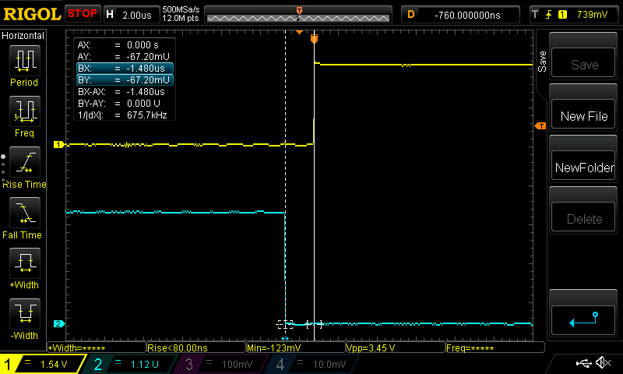

Slide 4
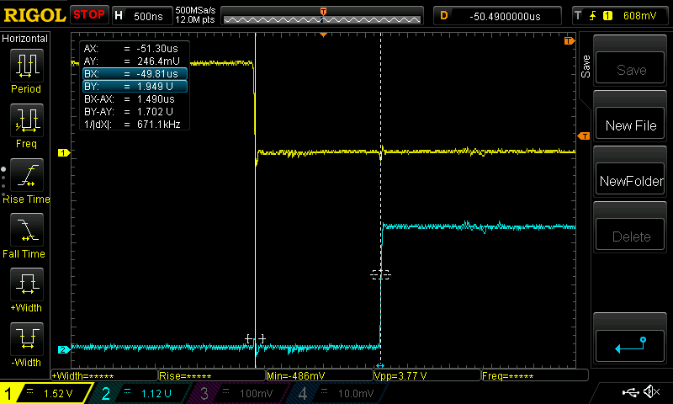

Slide 5
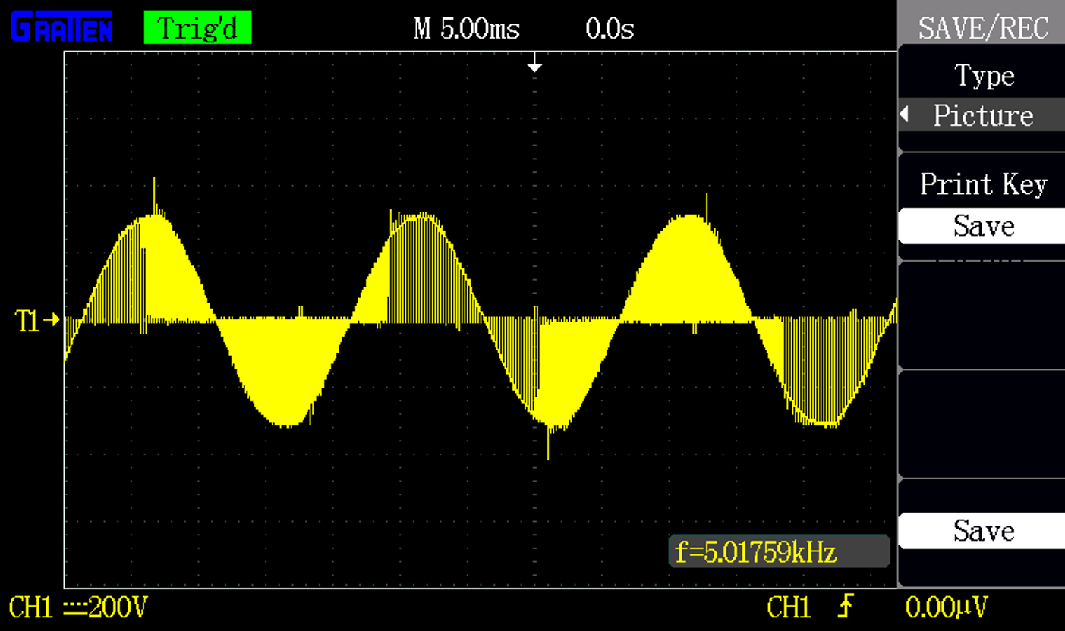

Slide 6
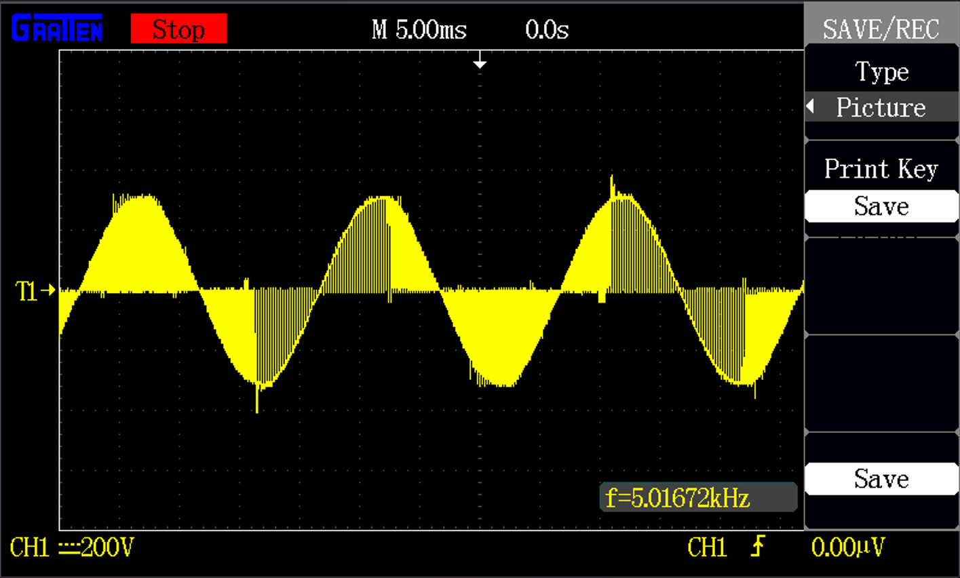
Duty Cycle: 70%

Slide 7
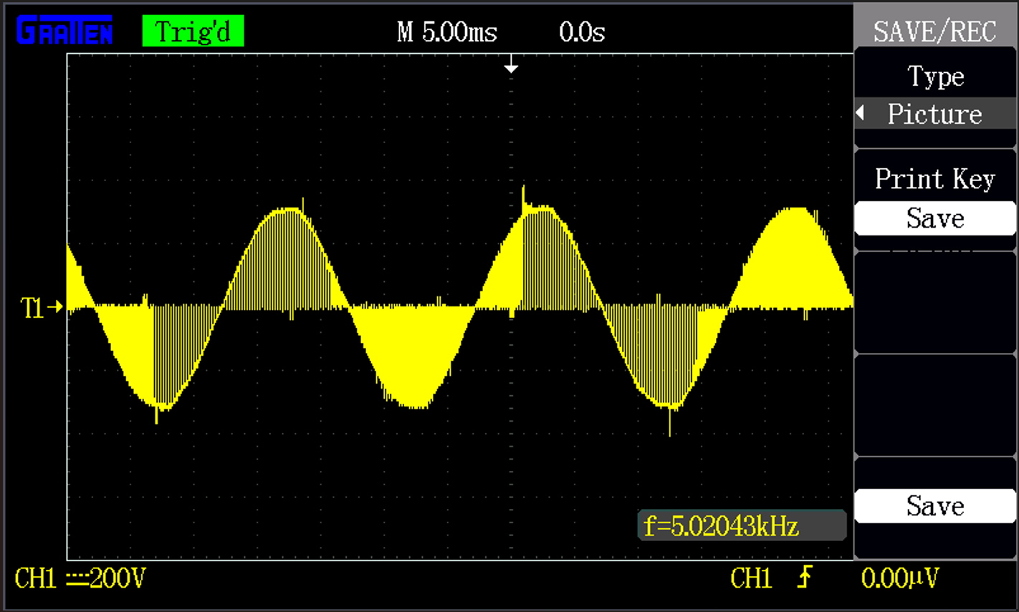
Duty Cycle: 75%

Slide 8
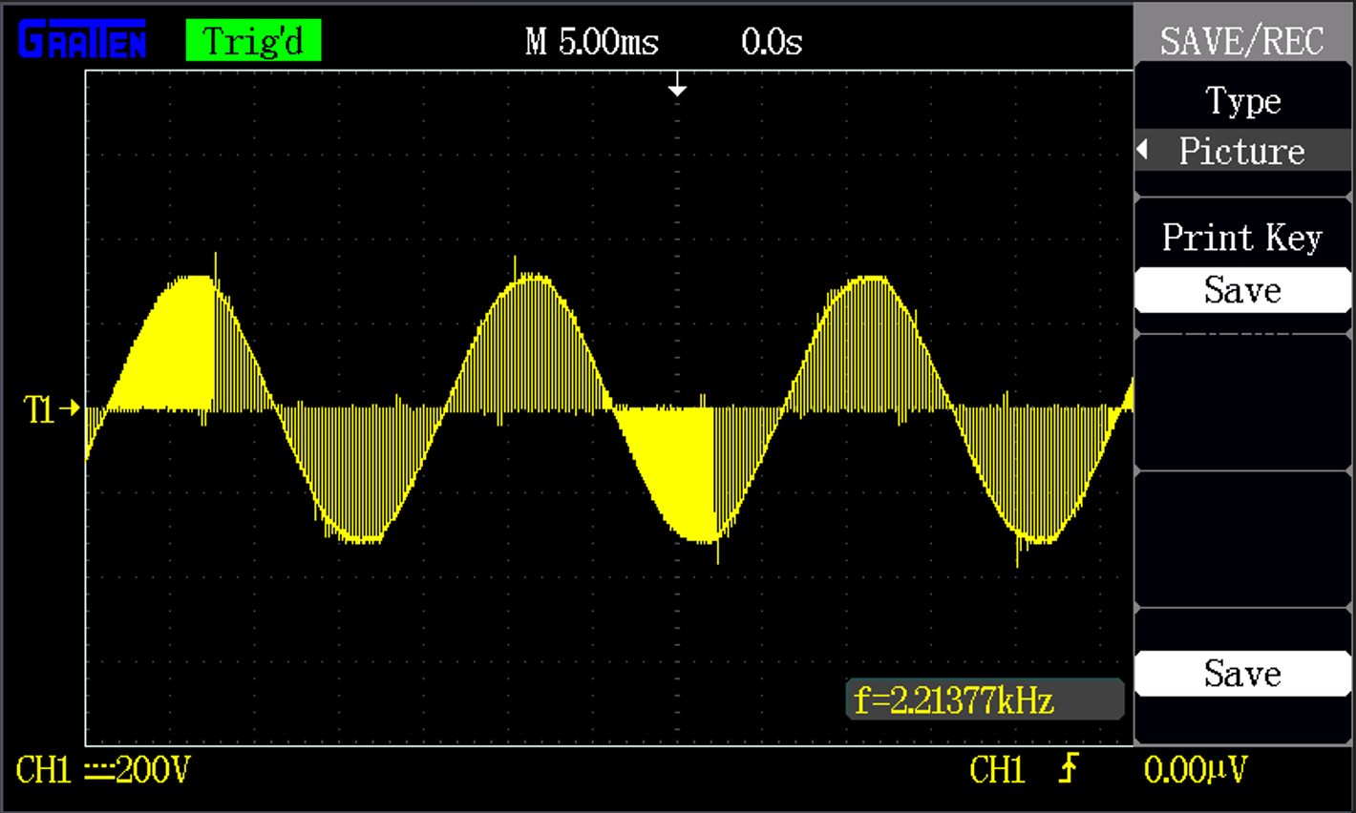
Duty Cycle: 80%

Slide 9
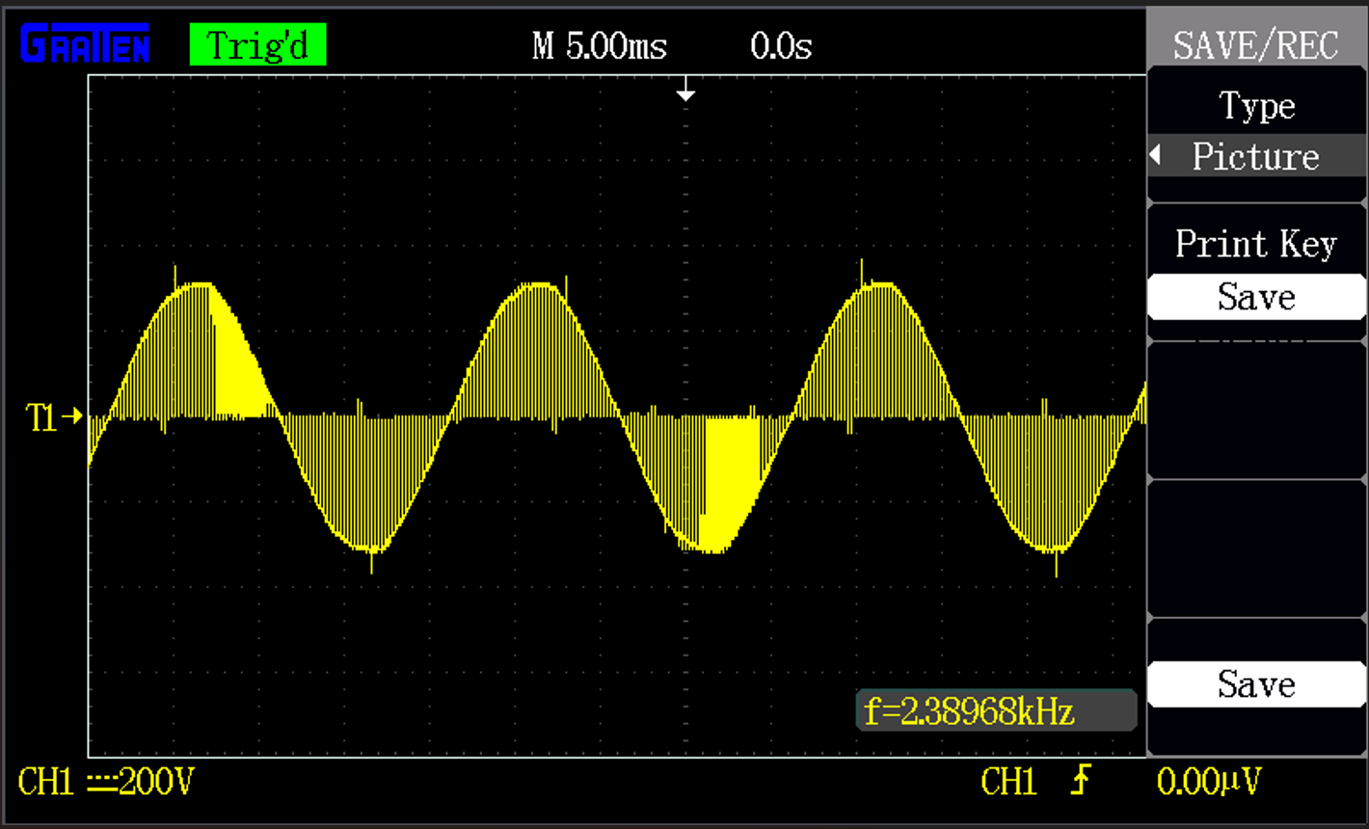
Duty Cycle: 85%

Slide 10
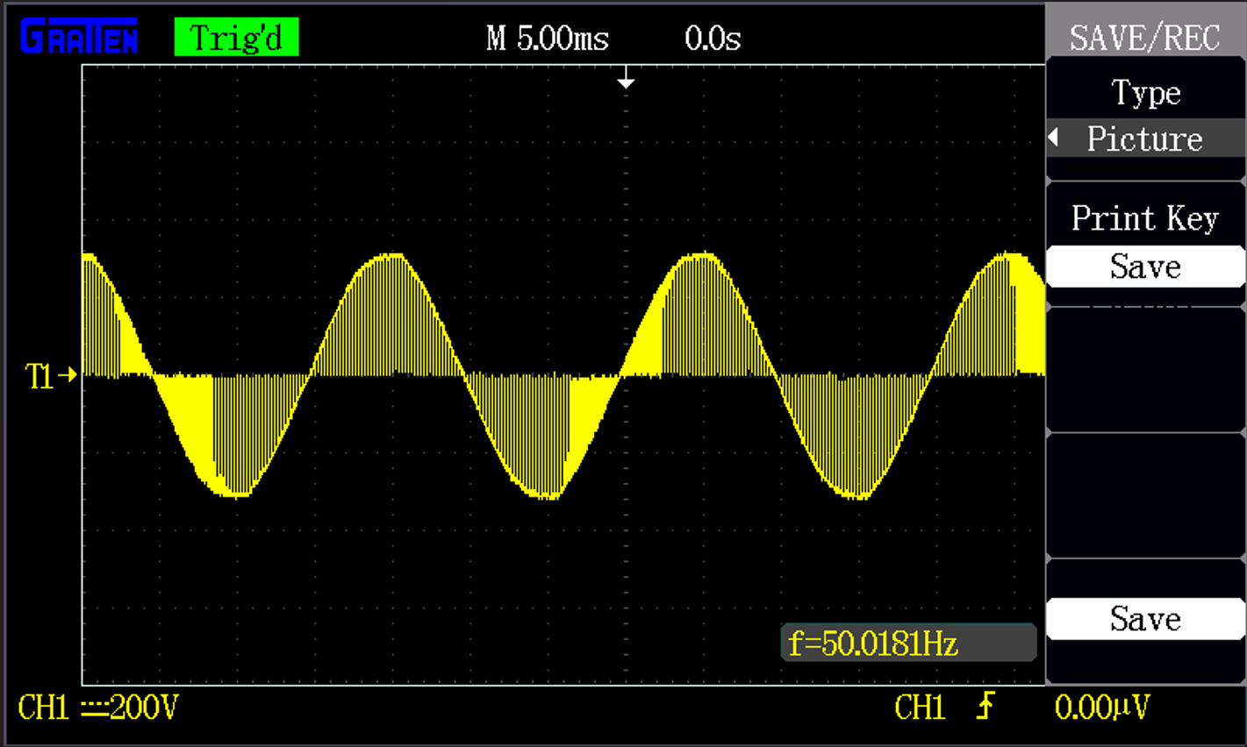
Duty Cycle: 90%

Slide 11
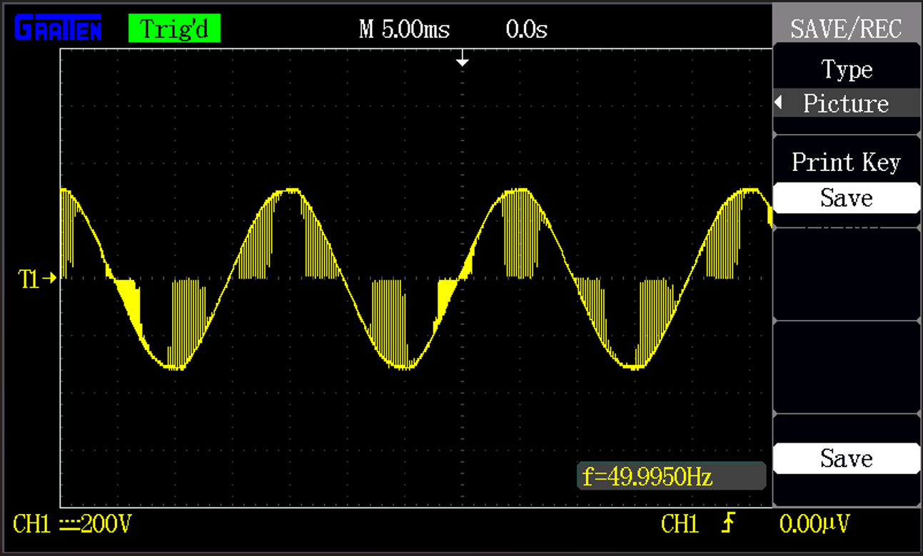
Duty Cycle: 95%

Slide 12
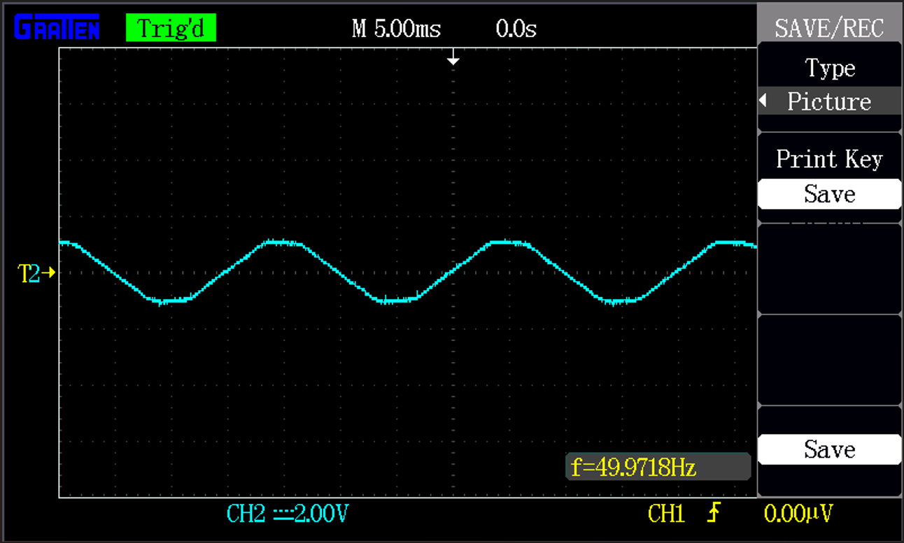
Duty Cycle: 95%

Slide 13
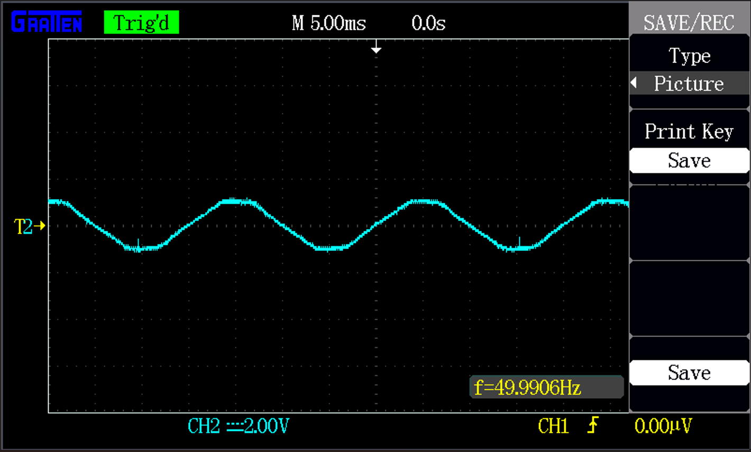
Duty Cycle: 90%

Slide 14
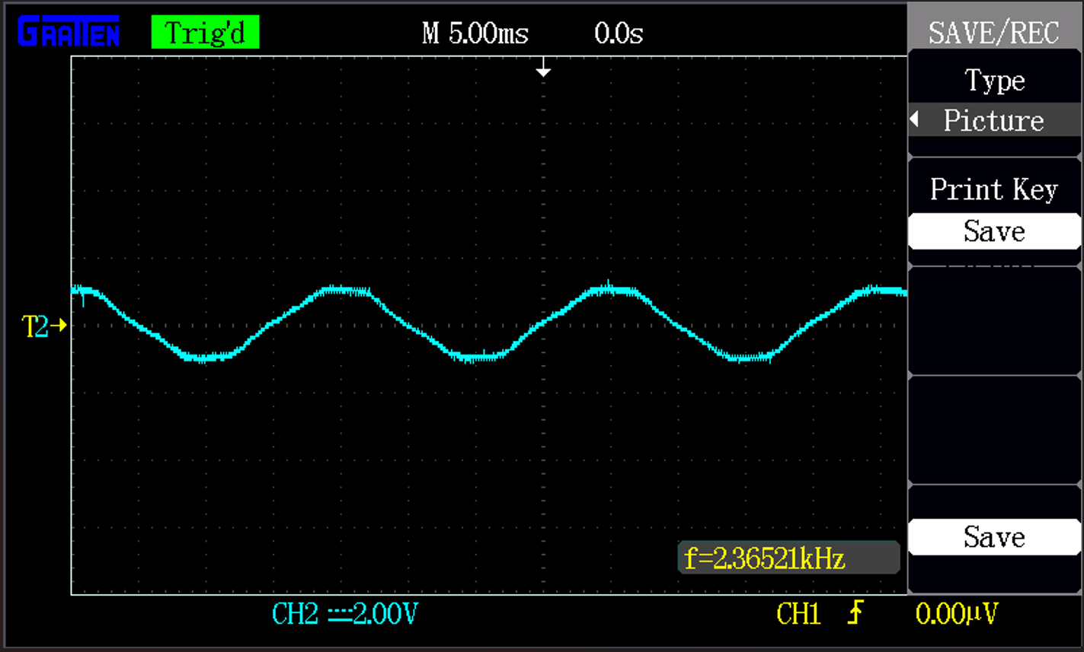
Duty Cycle: 85%

Slide 15
Duty Cycle: 80%

Slide 16
Duty Cycle: 75%

Slide 17
Duty Cycle: 70%

